Slide 1

Agriculture Automation using deep learning techniques Guide: Mrs.Devapriya I

Slide 2
Teammates: 1.Christopher Paul L URK19CS1173 2.Jestin Josephraj URK19CS1177 3. Johnson JP URK19CS1206 4. Kumaresan S URK19CS2012

Slide 3

Objective:
The main objective of our project is to create an mobile application which integrates the Plant classification, Soil type classification, Fruits Counting and smart Irrigation which uses Application Development, Automation, Cloud Computing, Deep Learning, Machine Learning and many more techniques.

Slide 4

Why?
Everyone has the rights to use technology, so the reason for choosing this project is to help the farmer and other people in this relevant field to have precise data and information so that it can help them to yield top Quality Products in efficient way.

Slide 5
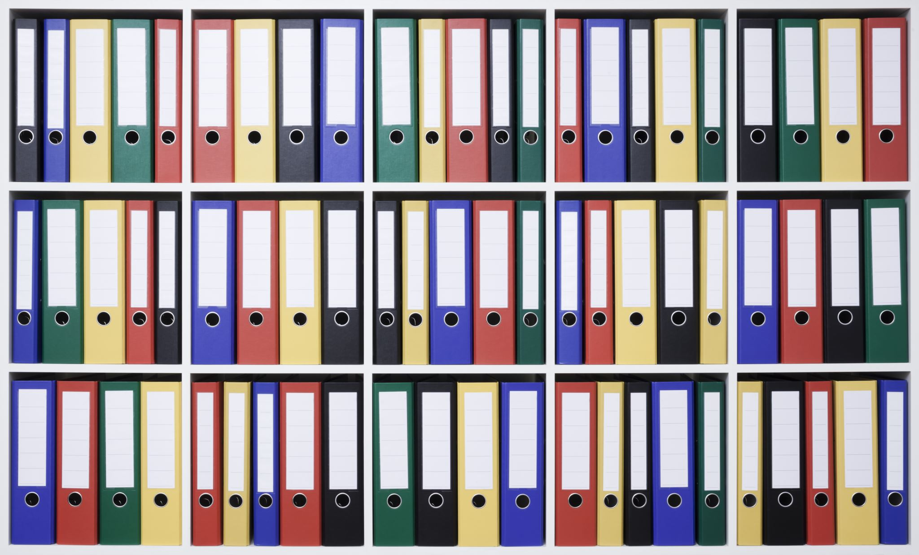
Reference Materials

Slide 6
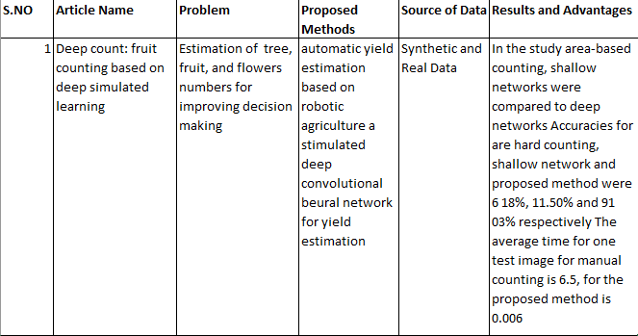

Slide 7
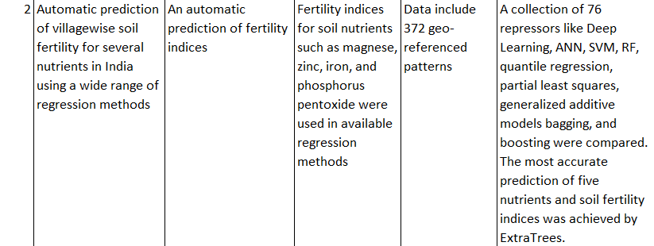

Slide 8

Thank You

